Slide 2
TEAMS
TRAINING FOR EMERGENCY MEDICAL TEAMS AND EUROPEAN MEDICAL CORPS
Luca Ragazzoni, MD, PhD
Project Coordinator
CRIMEDIM - Research Center in Emergency and Disaster Medicine

Slide 3
The ‘Emergency Medical Teams’ (EMTs) initiative evolved in 2010 under the umbrella of the WHO, the Global Health Cluster and other actors, with the aim to improve the quality and accountability of international emergency medical teams responding to disasters.
In 2013, the EMT Working Group published a first edition of the ‘Classification and minimum standards for Foreign Medical Teams in sudden onset disasters’, in which capacities, services and minimum deployment standards for EMTs were defined.

Slide 4
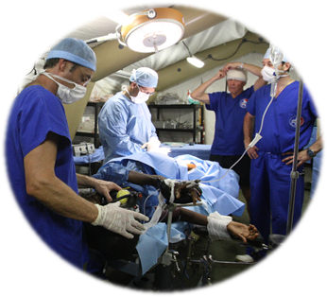
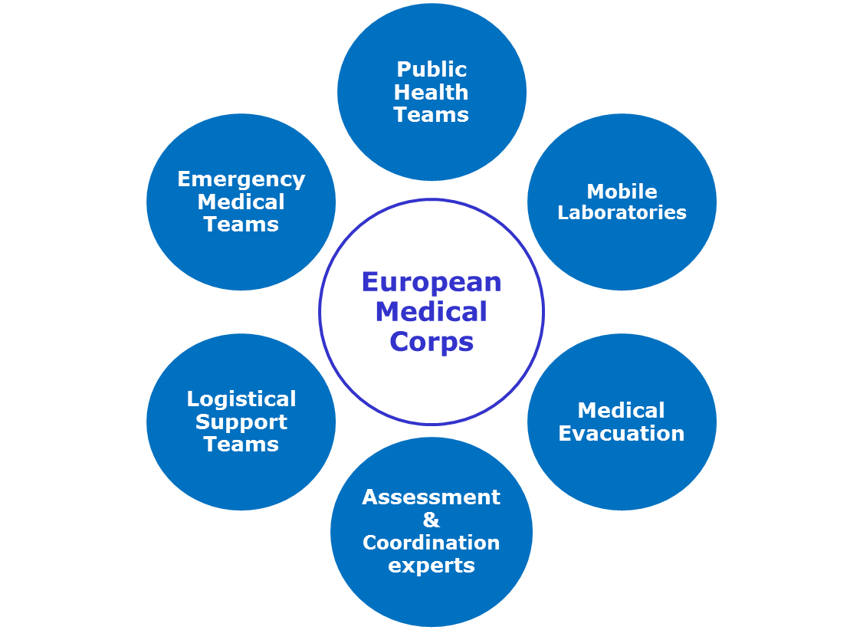
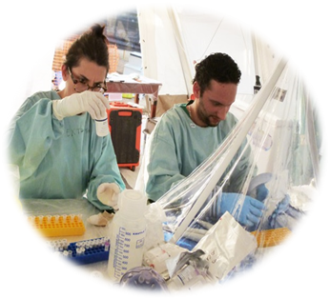
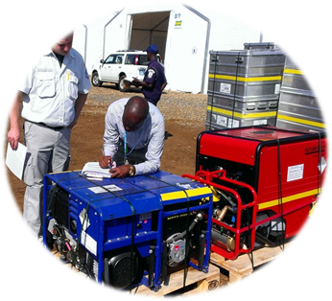
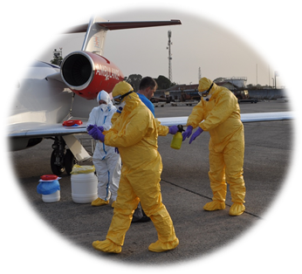
Notes:
I partecipanti possono muoversi all’interno di scenari in maniera realistica e con diversi punti di vista

Slide 5
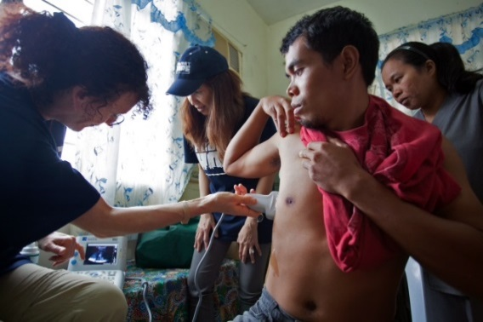
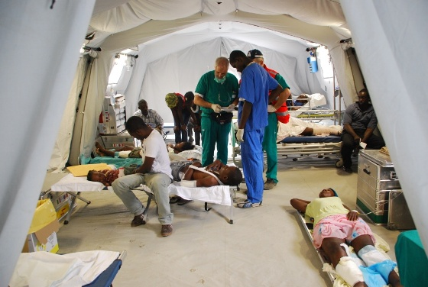
EMT COMPETENCY AREAS
Amat Camacho N, Hughes A, Burkle FM, Ingrassia PL, Ragazzoni L, Redmond A, Norton I, von Schreeb J. Education and Training of Emergency Medical Teams: Recommendations for a Global Operational Learning Framework. PLoS Curr. 2016 Oct 21;8.

Slide 6
THE PROJECT
TEAMS is a project, funded by the European Union Humanitarian Aid and Civil Protection (DG ECHO), aiming to develop, pilot and assess a standardized training package (set of simulation exercises), focused on operational team training (team dynamics) for EMCs/EMTs, adaptable to different types of EMCs/EMTs.
Specific aims:
1) To create a training framework focused on operational team training for EMCs/EMTs.
2) To develop teaching materials and identify effective training methods.
3) To implement a low-cost e-learning platform to facilitate the delivery of the teaching materials that is sustainable beyond the project.
4) To design a cost-effective set of simulation-based immersive scenarios for training EMCs/EMTs and facilitating quality assurance of these teams.
5) To pilot the overall training package through two main training events.
6) To assess the effectiveness of the training in terms of learning outcomes, participants’ satisfaction, improvement in technical and non-technical skills of the teams trained and cost-effectiveness.
7) To evaluate the quality of the training package.

Slide 7
METHODOLOGY AND TIMELINE
Task B. Analysis of situation and definition of training framework
Task C. Development of teaching materials and evaluation tools
Task D. Development of training tools and simulation scenarios
Task E. Pilot and assessment
HCRI - 6 months
KI - 9 months
UPO - 10 months
TAU – HUM – IMU - 15 months
January
2017
July
October
2018
March
April
December
2018
Notes:
I partecipanti possono muoversi all’interno di scenari in maniera realistica e con diversi punti di vista

Slide 8
MAIN CARACTERISTICS OF THE TRAINING PACKAGE
Set of 8 team dynamics exercises, based on a curriculum framework developed through a scientific methodology.
Characteristics:
Special focus on health-related exercises
Scenario based
No need for external trainers: this is an EMT self- delivered training package.
Build upon EMT minimum standards
Based on the own EMT procedures and equipment
The learning objectives should not focus on the technical aspects (i.e triage) but on the team’s performance in terms of team dynamics.

Slide 9
SUSTAINABILITY AND CONTINUATION
The online training package will be available free of charge after the end of the project to allow continuing access to and the usability of the teaching and training materials by the final beneficiaries all over the world.
The online platform will be developed with a capacity to be easily accessible from all over the world and to be maintained with no cost over time.
The consortium takes the responsibility for the quality assurance and evaluation mechanism of each training delivered by using the TEAMS training package through an online assessment methodology.
Notes:
I partecipanti possono muoversi all’interno di scenari in maniera realistica e con diversi punti di vista

Slide 10
Thank you.

