Slide 1
TEAMS 3.0
TRAINING FOR EMERGENCY MEDICAL TEAMS AND EUROPEAN MEDICAL CORPS
Luca Ragazzoni, MD, PhD
Project Coordinator
CRIMEDIM - Research Center in Emergency and Disaster Medicine

Slide 2
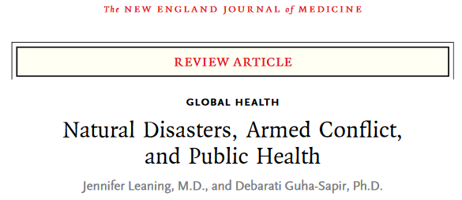
Concerns regarding the standard of medical care provided in disasters and the lack of preparedness of health workers has been raised.
Health practitioners have been observed to work outside their scope of practice and license, and teams have lacked basic capacities and logistic means to operate self-sufficiently.
Additional concerns have been highlighted regarding the lack of cultural awareness and coordination with local authorities as well as international agencies.

Slide 3
The ‘Emergency Medical Teams’ (EMTs) initiative evolved in 2010 under the umbrella of the WHO, the Global Health Cluster and other actors, with the aim to improve the quality and accountability of international emergency medical teams responding to disasters.
In 2013, the EMT Working Group published a first edition of the ‘Classification and minimum standards for Foreign Medical Teams in sudden onset disasters’, in which capacities, services and minimum deployment standards for EMTs were defined.

Slide 4
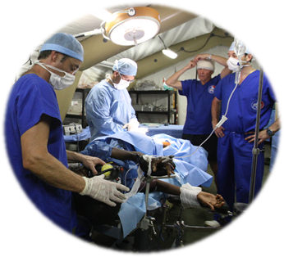
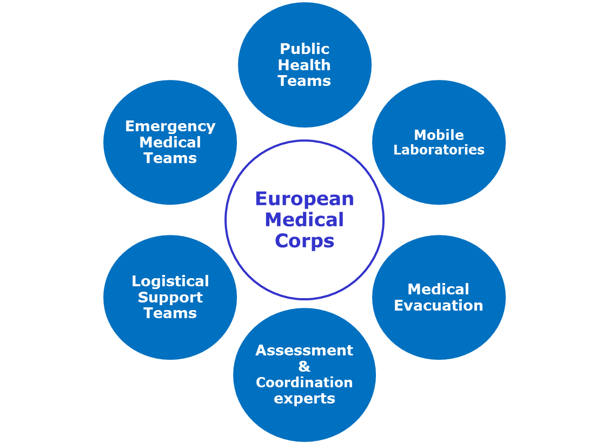
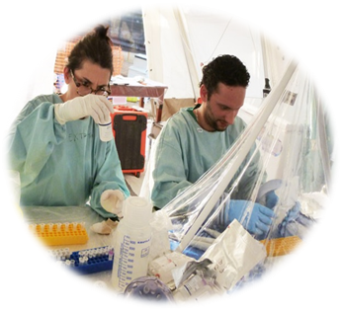
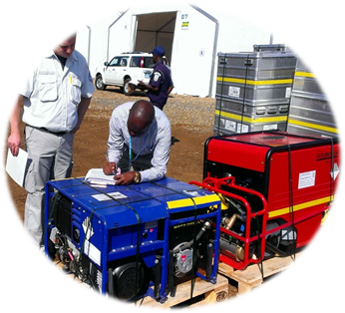
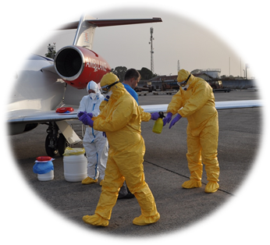
Notes:
I partecipanti possono muoversi all’interno di scenari in maniera realistica e con diversi punti di vista

Slide 5
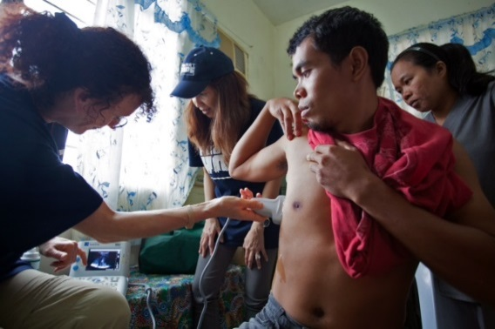
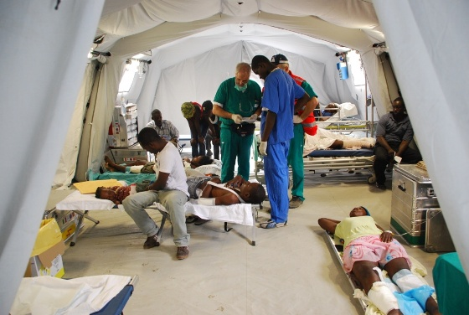
EMT Competency Areas
Amat Camacho N, Hughes A, Burkle FM, Ingrassia PL, Ragazzoni L, Redmond A, Norton I, von Schreeb J. Education and Training of Emergency Medical Teams: Recommendations for a Global Operational Learning Framework. PLoS Curr. 2016 Oct 21;8.

Slide 6
The TEAMS projects: TEAMS 1.0
In December 2018 the TEAMS 1.0 project, founded by the ECHO ‘Prevention and Preparedness Call for Proposal 2016’, successfully delivered an innovative operational training package focused on teamwork to assist EMTs in preparing for deployment.
Since the completion of TEAMS 1.0 project, EMTs around the world have been having the option to access a validated training package comprised of a set of 8 simulation-based exercises specifically designed to improve EMTs' team performance through scenarios likely to be encountered on the field.
The TEAMS training package is available online free-of-charge at the following link: www.teams-project.eu/teams-training-package

Slide 7
The TEAMS projects: TEAMS 2.0
Following the success of TEAMS 1.0 project, in December 2019 the TEAMS 2.0 project, founded by the ECHO ‘Prevention and Preparedness Call for Proposal 2017’, delivered an innovative Training of Trainers program composed of e-learning modules and face-to-face workshops focused on ToT learning activities to train novice team leaders and training managers of EMC/EMT organizations on how to effectively use the TEAMS training package.
Since the completion of TEAMS 2.0, the e-learning platform, called The Trainer’s Compass, is available online always at no cost: www.teams-project.eu/teams-training-package.

Slide 8
TEAMS training package
TEAMS training package is currently composed of 8 modules, focused on operational team training for EMCs/EMTs, adaptable to different types of EMCs/EMTs, and sustainable within resource-poor settings.
Key characteristics:
Each exercise is a complete stand-alone module consisting of a concept note, learning objectives matrix, debriefing tool and a variety of supplementary documents;
The exercises can be delivered sequentially, in a 3-day intensive training simulating a humanitarian mission, or can be performed independently to accommodate each organization’s specific needs, time and resources;
The training package is available online through an e-learning platform to facilitate the delivery;
It underwent a series of validation and assessment phases: it was piloted in two main training events, its effectiveness was assessed in terms of learning outcomes, participants’ satisfaction, improvement in technical and non-technical skills of the teams trained and cost-effectiveness, its quality was evaluated.
It comes with a complementary training of trainers’ package, addressed to novice team leaders and training managers, providing them a specific training on how to effectively use the TEAMS training package.
Notes:
I partecipanti possono muoversi all’interno di scenari in maniera realistica e con diversi punti di vista

Slide 9
TEAMS project video
Notes:
I partecipanti possono muoversi all’interno di scenari in maniera realistica e con diversi punti di vista

Slide 10
TEAMS 3.0
Both TEAMS 1.0 and 2.0 have achieved the expected results. However, the TEAMS training package needs continuous revision and improvement:
It needs to continuously adapt to the unceasing evolution of EMC and EMT initiatives
it is currently addressing only natural disasters, lacking scenarios and exercises focusing on outbreaks, man-made disasters and other possible cross-border risks
Only two EMT organizations have officially delivered the entire TEAMS training package.
Notes:
I partecipanti possono muoversi all’interno di scenari in maniera realistica e con diversi punti di vista

Slide 11
Based on this analysis, TEAMS 3.0 will address the following objectives:
1) revise and update the TEAMS training package involving new partners, experts and EU EMT organizations;
2) develop new scenarios and exercises for the TEAMS training package to train EMTs to respond to outbreaks, man-made disasters and other possible cross-border risks;
3) disseminate and deliver the updated TEAMS training package engaging four EMTs in Europe to enhance cross-border emergency management through training programmes and joint cross-border small-scale exercises.

Slide 12
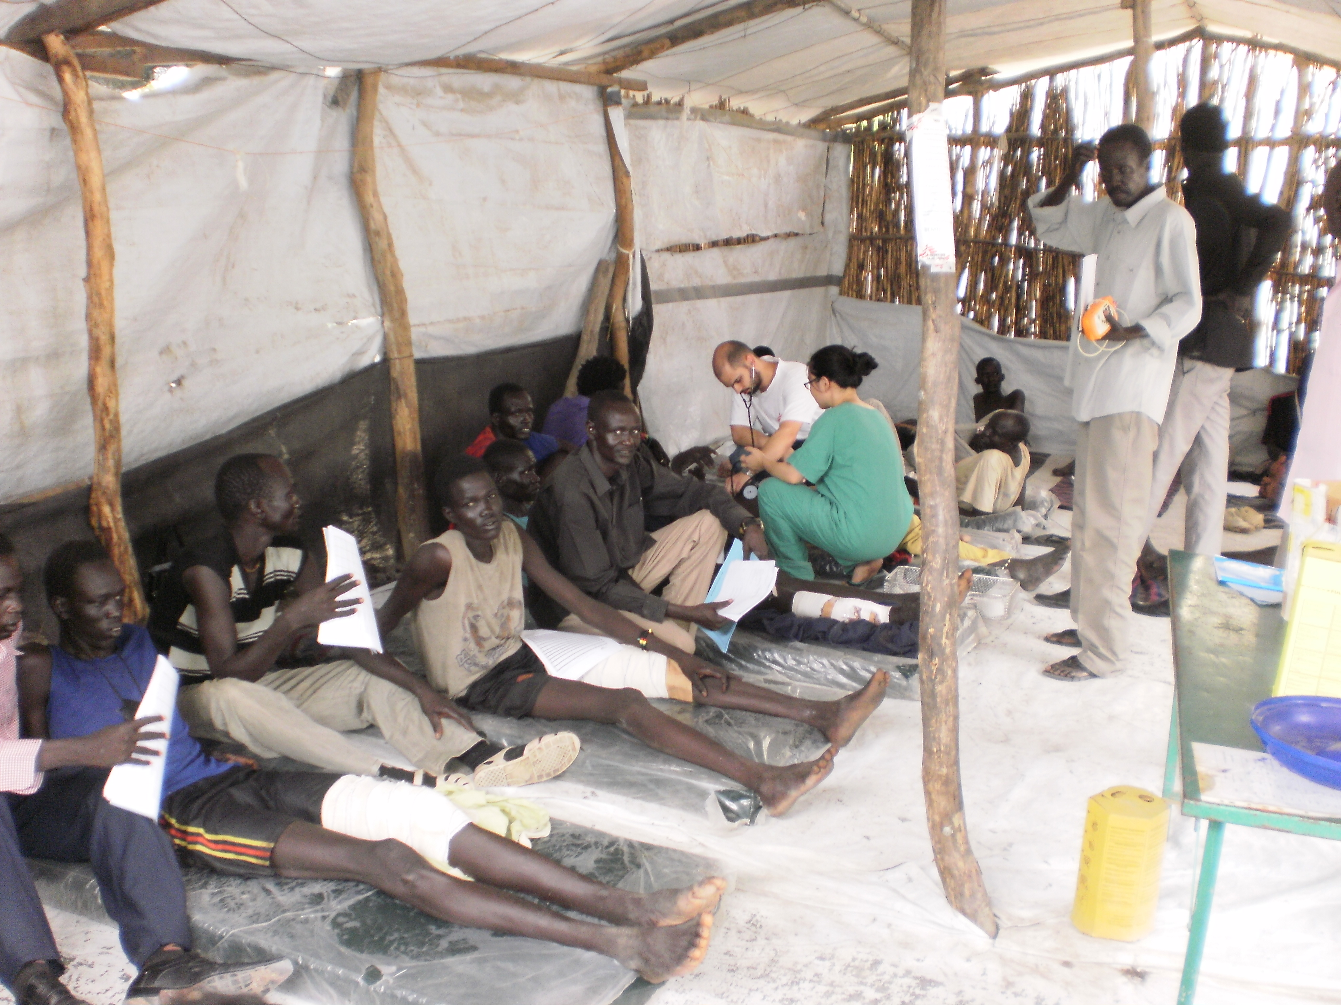
Expected Result
At the end of the project, the current TEAMS training package will be updated and improved with new scenarios and exercises to train EMTs to respond to outbreaks, man-made disasters and other possible cross-border risks in Europe and EU Neighbourhood countries. Moreover, more EMTs in Europe will be trained and their cross-border operational collaboration and interoperability in disaster response tested and strengthened.
Beneficiaries
All the EMC/EMT organizations, as well as universities, professional bodies and training agencies that are involved in EMC/EMT training as they look to comply with ECHO and WHO classification and minimum standards.
Notes:
I partecipanti possono muoversi all’interno di scenari in maniera realistica e con diversi punti di vista

Slide 13
Methodology and Timeline: a four phases action
Phase 1: Analysis of the situation: evolution of EMTs operations and standards and EU disaster risk profile
Phase 2. Update of training package and development of new exercises
Phase 3. Updated ToT delivered to IMU, HDIR, INEM and JOHANNITER training managers
Phase 4. TEAMS training delivered to IMU, HDIR, INEM and JOHANNITER and evaluated
KI & GERTNER - 4 months (Dec 2020-Mar 2021)
KI - 4 months (April 2021 – July 2021)
UPO - 3 months (August 2021-October 2021)
GERTNER & IMU, HDIR,INEM, JOHANNITER – 12 months (November 2021-November 2022)
December 2022
Notes:
I partecipanti possono muoversi all’interno di scenari in maniera realistica e con diversi punti di vista

Slide 14
Phase 1: Analysis of the situation
Task 2.1: Revision and update of the TEAMS training package (KI)
1. A scoping review to collect new documents, articles and operating procedures released and published in the last two years about EMTs operations and standards (e.g. Blue Book, Red Book, documents regarding the EMC initiative, peer-reviewed articles published in scientific journal).
2. A Consortium face-to-face meeting to discuss the findings of the scoping review and obtain expert consensus regarding the revision to make.
Task 2.2: Evaluation and selections of new disaster scenarios (GERTNER) 1. A scoping review to evaluate the current EU and Neighbourhood countries disaster risk profile, understand the current cross-border threats to health and map the Member States prone to the same types of disasters based on recent EC and national documents which report risk assessment (e.g. 2017 Overview of Risks, national risk assessments submitted to the EC in 2018/2019).
2. A Consortium face-to-face meeting to discuss the findings of the scoping review and obtain expert consensus regarding the new disaster scenarios to address.
Notes:
I partecipanti possono muoversi all’interno di scenari in maniera realistica e con diversi punti di vista

Slide 15
Phase 2: Update of the training package
Task 2.3: Development of new exercises (KI)
The TEAMS training package will be updated and improved according to the results of the expert consensus recommendations.
New simulation-based exercises will be developed and added to address the disaster scenarios selected by the expert consensus.
The new exercises will be uploaded in the online TEAMS platform.
Notes:
I partecipanti possono muoversi all’interno di scenari in maniera realistica e con diversi punti di vista

Slide 16
Phase 3: Updated training of trainers
Task 3.1: TEAMS training of trainers (UPO)
An updated version of the Training of Trainers will be organised and delivered to train new training managers from IMU, HDIR, INEM and JOHANNITER.
Guest EMT professionals will be invited from neighbouring countries (e.g. Greece, Sweden, Spain and Poland).
The program will be composed by two complementary learning phases: a distance learning module (2 weeks) and a residential course (2 days).
New workshops will be added to explain how to organise and deliver the new exercises created.
Notes:
I partecipanti possono muoversi all’interno di scenari in maniera realistica e con diversi punti di vista

Slide 17
Phase 4: Updated training of trainers
Task 4.1: Mentor the organization of four TEAMS trainings (GERTNER + all beneficiaries)
The new training managers from IMU, HDIR, INEM and JOHANNITER and the guest EMT professionals from neighbouring countries trained during the ToT in Italy, will be in charge to organize, manage and deliver the four trainings for their own EMT organization, supported and mentored by GERTNER and the whole project consortium
Task 4.2: Evaluation of the four trainings (GERTNER)
The assessment tools developed during TEAMS 1.0 and 2.0 will be used to assess the TEAMS trainings. The interpretation of the evaluation results will be laid down in an evaluation report of the four trainings delivered.
Notes:
I partecipanti possono muoversi all’interno di scenari in maniera realistica e con diversi punti di vista

Slide 18
Transversal tasks: project coordination and dissemination
Project Coordination (UPO)
UPO, through its Research Center in Disaster Medicine (CRIMEDIM) will coordinate all activities of the projects. This activity includes:
The overall coordination of the project, ensuring that the project stays focused and that there is a good cooperation and coordination between all Work Packages and Activities
Administration and control of the project, including risk management and problem handling, financial administration and control
Organisation of consortium meetings (months 12, months 18 and month 24)
Notes:
I partecipanti possono muoversi all’interno di scenari in maniera realistica e con diversi punti di vista

Slide 19
Transversal tasks: project coordination and dissemination
Dissemination and communication (Novareckon)
Novareckon will be responsible of disseminating the project approach and results over a wide audience, using three main channels:
offline communication: project flyiers, publication of articles, participation to events),
online communication: a TEAMS 3.0 pae on the website, newsletters) and
project events: a final conference will be held in Brussels at the end of the project to present the project activities and key results to a wide audience).
Notes:
I partecipanti possono muoversi all’interno di scenari in maniera realistica e con diversi punti di vista

Slide 20
Thank you
Luca Ragazzoni, MD, PhD
Project Coordinator
CRIMEDIM - Research Center in Emergency and Disaster Medicine

